Slide 2
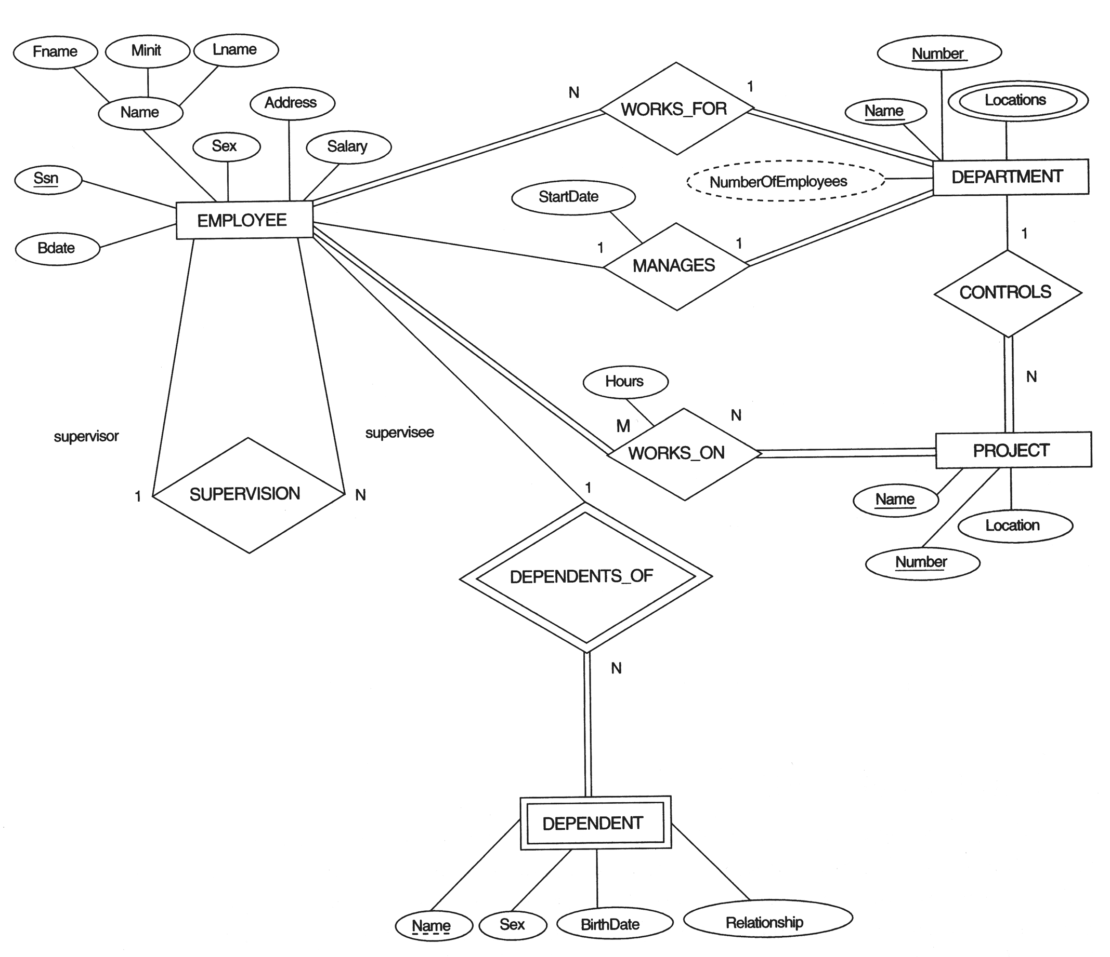

Slide 3
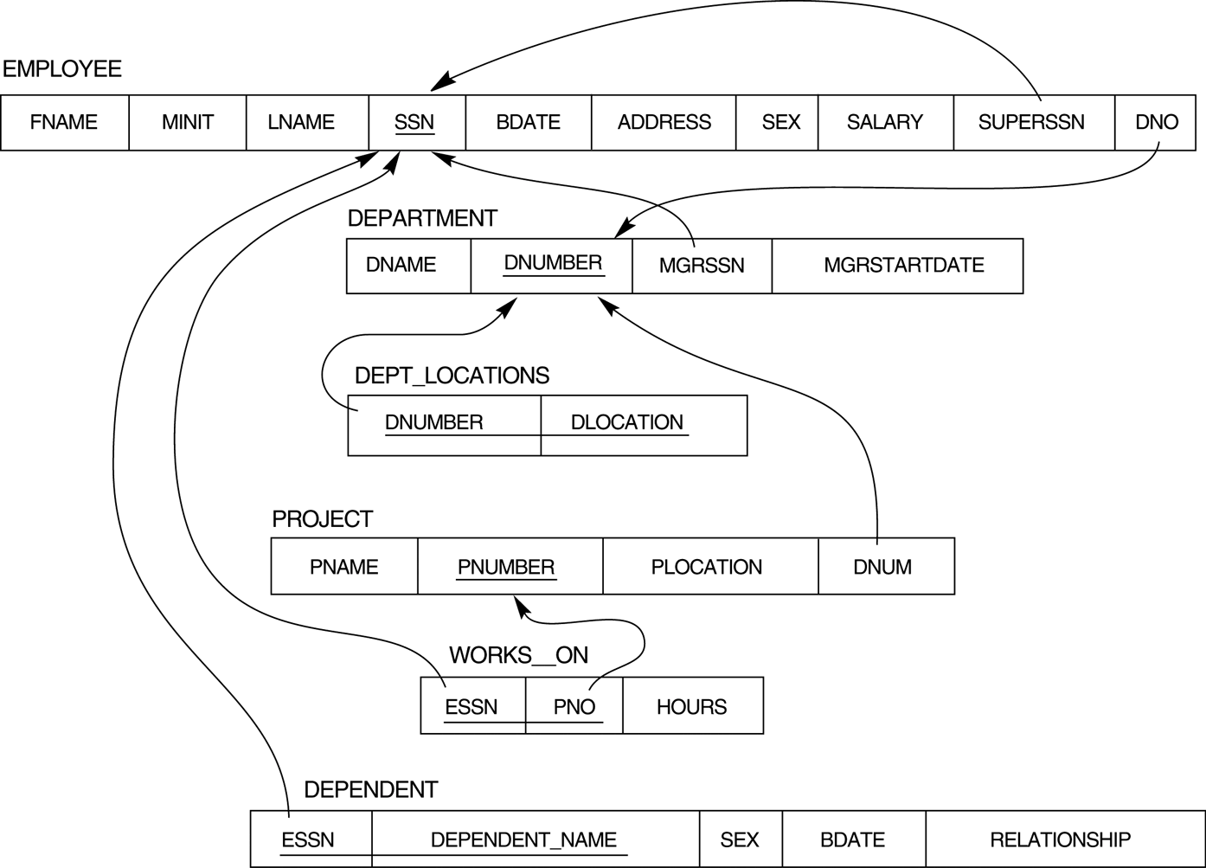
FIGURE 7.2 Result of mapping the COMPANY ER schema into a relational schema.

Slide 5
EER-to-Relational Mapping

Slide 6
EER-to-Relational Mapping
Options for Mapping Specialization or Generalization.
Convert each specialization with m subclasses {S₁, S₂,….,S_{m}} and generalized superclass C, where the attributes of C are {k,a₁,…a_{n}} and k is the (primary) key, into relational schemas using one of the four following options:
Option 8A: Multiple relations-Superclass and subclasses.
Create a relation L for C with attributes Attrs(L) = {k,a₁,…a_{n}} and PK(L) = k.
Create a relation L_{i} for each subclass S_{i}, 1 <= i <= m, with the attributes
Attrs(L_{i}) = {k} U {attributes of S_{i}} and PK(L_{i})=k.
This option works for any specialization (total or partial, disjoint of over-lapping).
Option 8B: Multiple relations-Subclass relations only
Create a relation L_{i} for each subclass S_{i}, 1 <= i <= m, with the attributes
Attr(L_{i}) = {attributes of S_{i}} U {k,a₁…,a_{n}} and PK(L_{i}) = k.
This option only works for a specialization whose subclasses are total (every entity in the superclass must belong to (at least) one of the subclasses)

Slide 7
EER-to-Relational Mapping
Option 8C: Single relation with one type attribute
Create a single relation L with attributes Attrs(L) = {k,a₁,…a_{n}} U {attributes of S₁} U…U {attributes of S_{m}} U {t} and PK(L) = k. The attribute t is called a type (or discriminating) attribute that indicates the subclass to which each tuple belongs
Option 8D: Single relation with multiple type attributes
Create a single relation schema L with attributes Attrs(L) = {k,a₁,…a_{n}} U {attributes of S₁} U…U {attributes of S_{m}} U {t₁, t₂,…,t_{m}} and PK(L) = k. Each t_{i}, 1 <= i <= m, is a Boolean type attribute indicating whether a tuple belongs to the subclass S_{i}
Option 8A is preferred !!

Slide 8
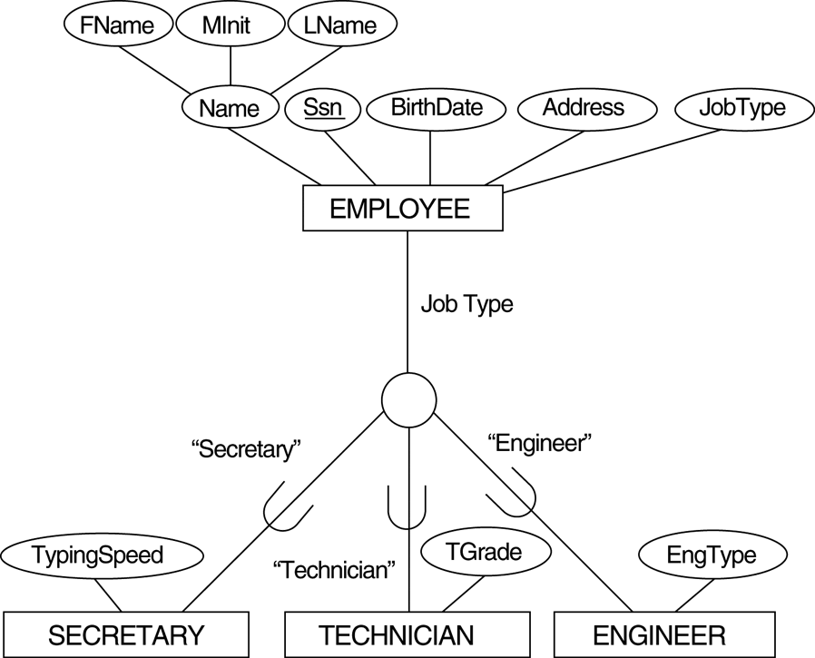
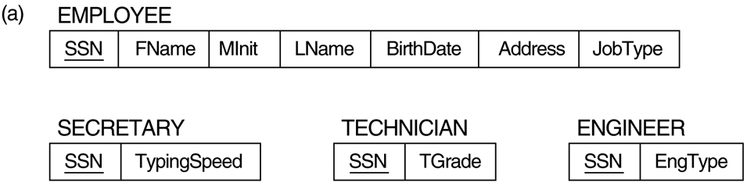
Example: Option 8A

Slide 9
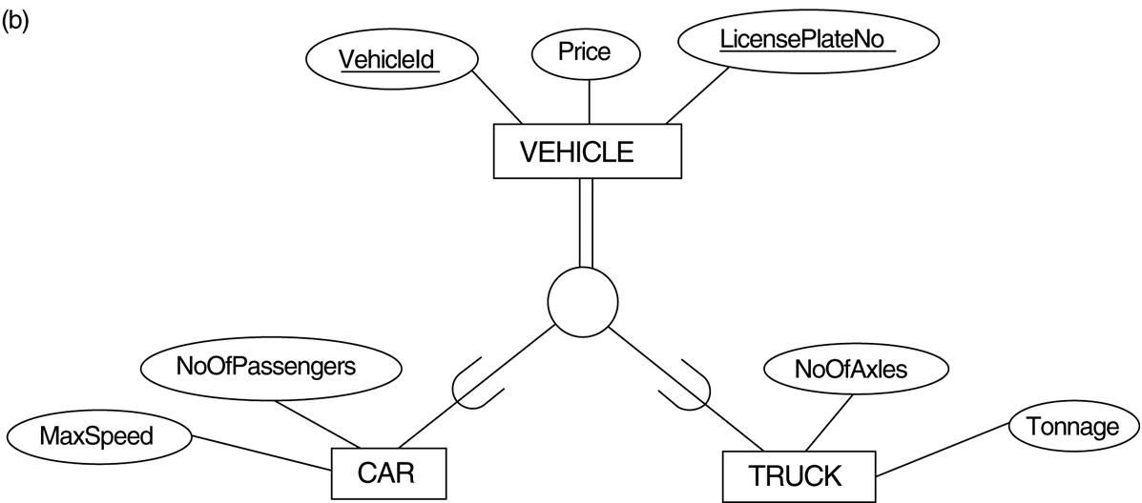
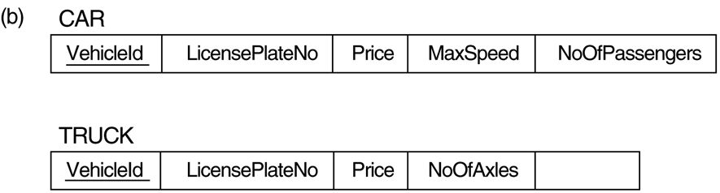
Example: Option 8B
Tonnage

Slide 10

Example: Option 8C
EngType
Serving as the type attribute

Slide 11
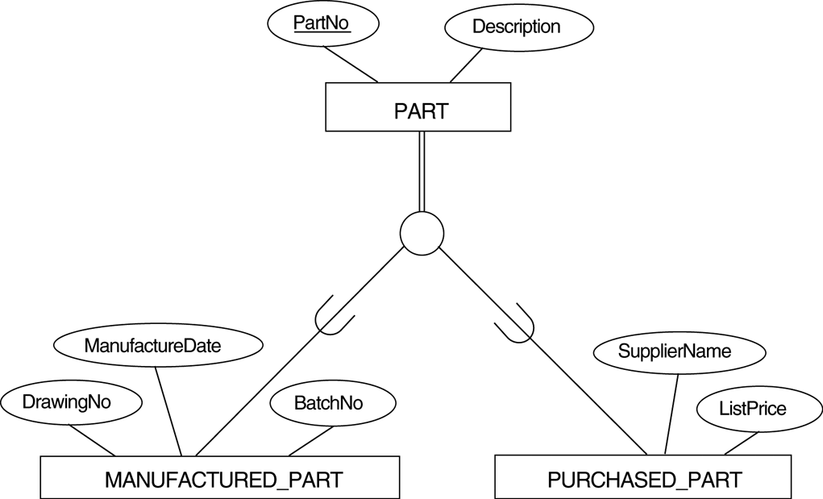
Example: Option 8D
Boolean type attributes

Slide 12
EER-to-Relational Mapping
Mapping of Shared Subclasses (Multiple Inheritance)
A shared subclass, such as STUDENT_ASSISTANT, is a subclass of several classes, indicating multiple inheritance. These classes must all have the same key attribute; otherwise, the shared subclass would be modeled as a category.
We can apply any of the options discussed in Step 8 to a shared subclass, subject to the restriction discussed in Step 8 of the mapping algorithm. Below both 8C and 8D are used for the shared class STUDENT_ASSISTANT

Slide 13
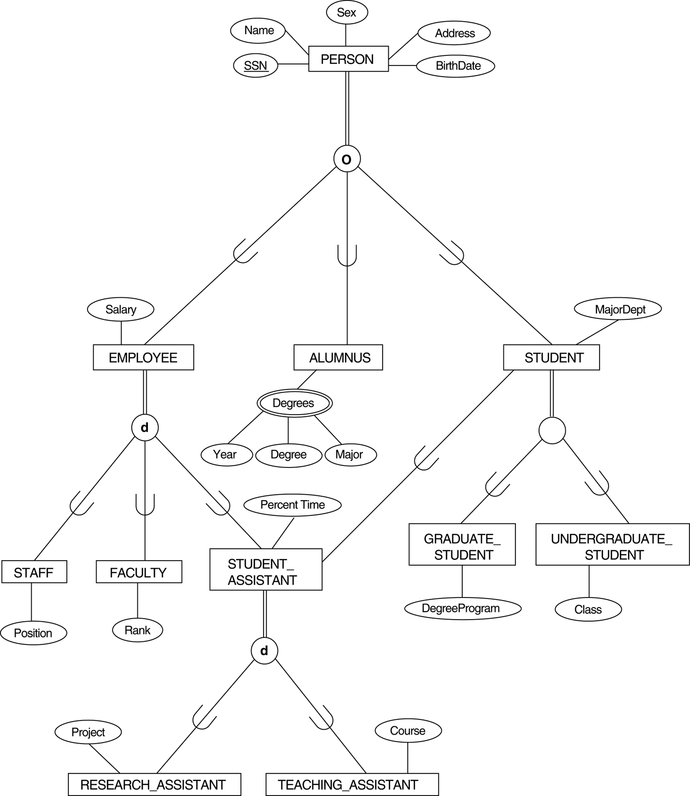
Example: Mapping of Shared Subclasses

Slide 14
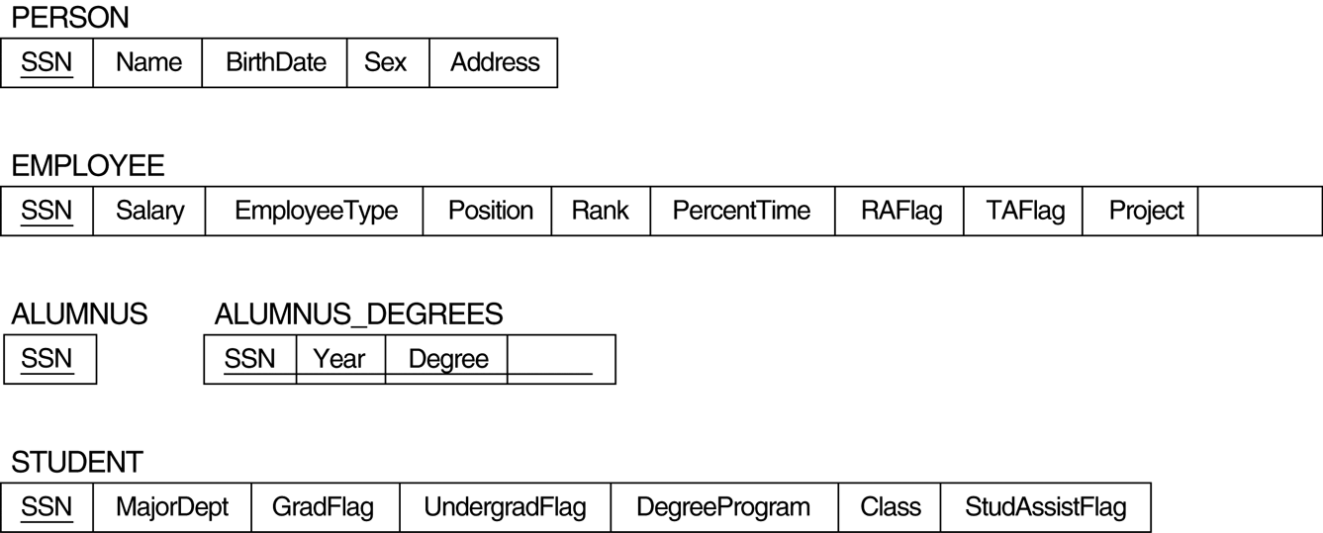
Example: Mapping of Shared Subclasses
Course
Major

Slide 15
EER-to-Relational Mapping
Step 9: Mapping of Union Types (Categories).
For mapping a category whose defining superclasses have different keys, it is customary to specify a new key attribute, called a surrogate key, when creating a relation to correspond to the category.
In the example below we can create a relation OWNER to correspond to the OWNER category and include any attributes of the category in this relation. The primary key of the OWNER relation is the surrogate key, which we called OwnerId
We also include the surrogate key attribute OwnerId as FK in each relation corresponding to a superclass of the category in order to specify the correspondence in values between the surrogate key and the PK of each superclass

Slide 16
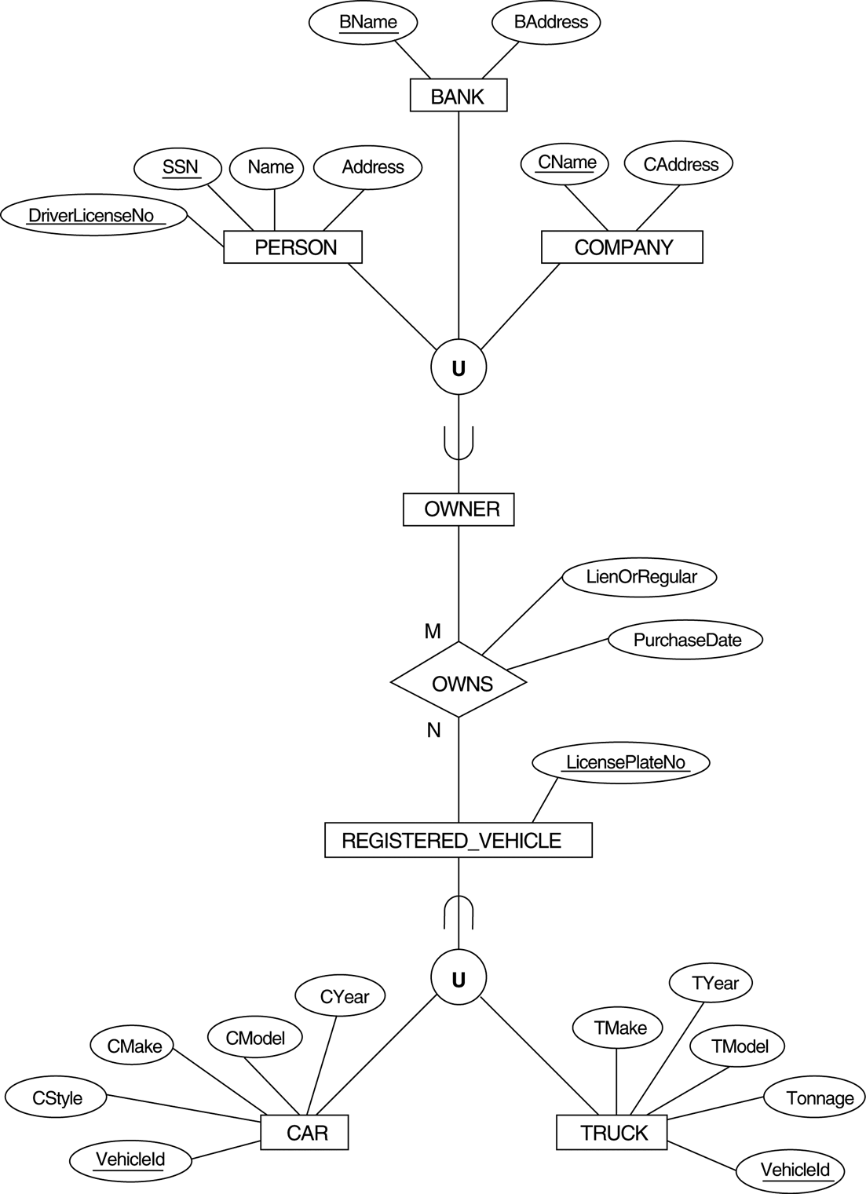
Example

Slide 17
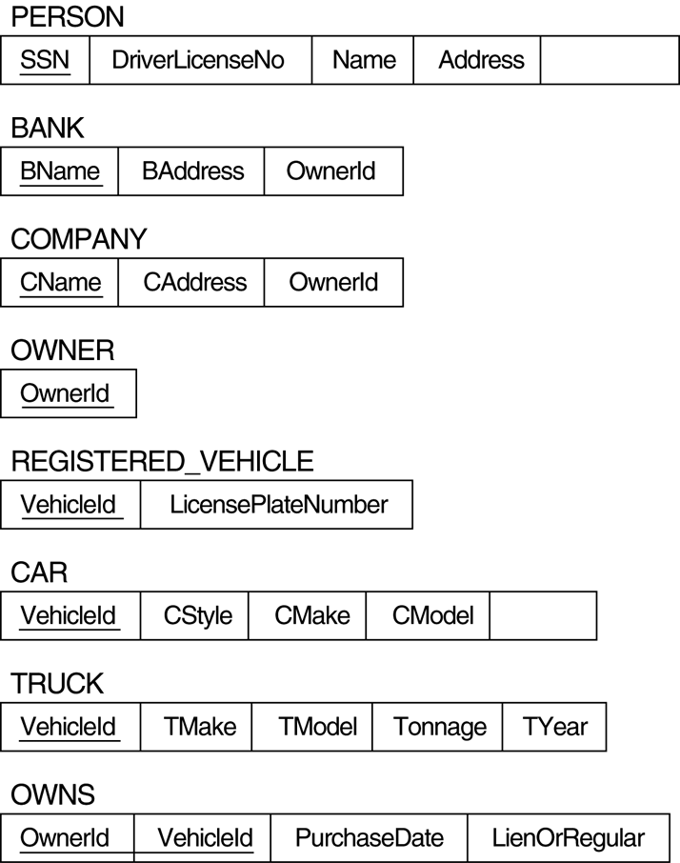
Example
OwnerId
CYear

Slide 18
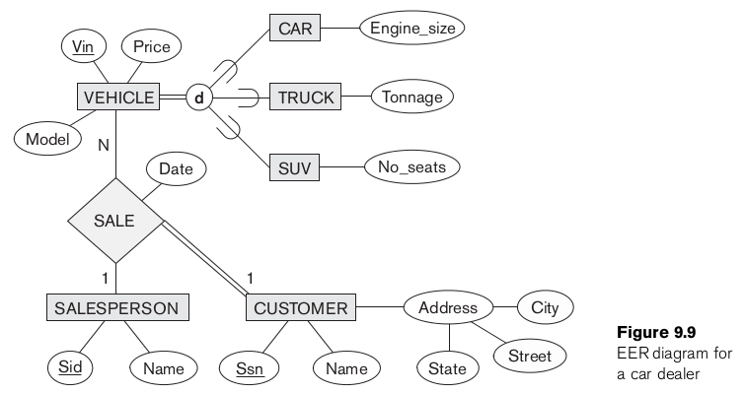

Slide 19
